Slide 1
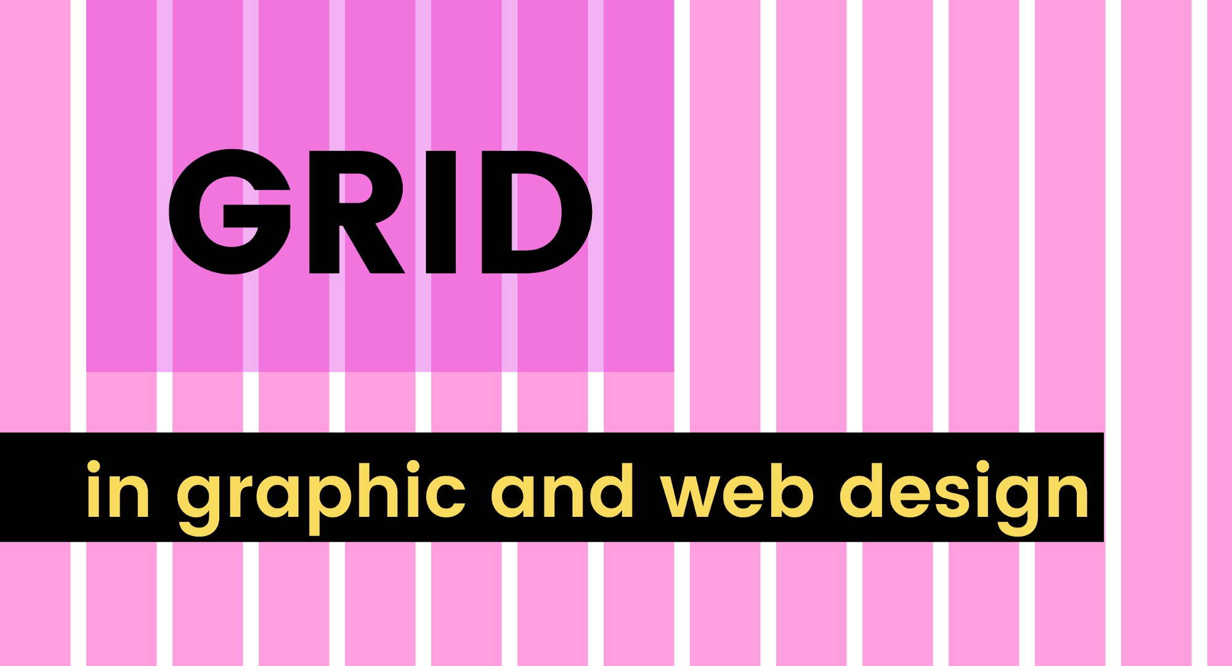

Slide 2
Today’s Content
Grids
Rule of Thirds
Rule of Odds

Slide 3
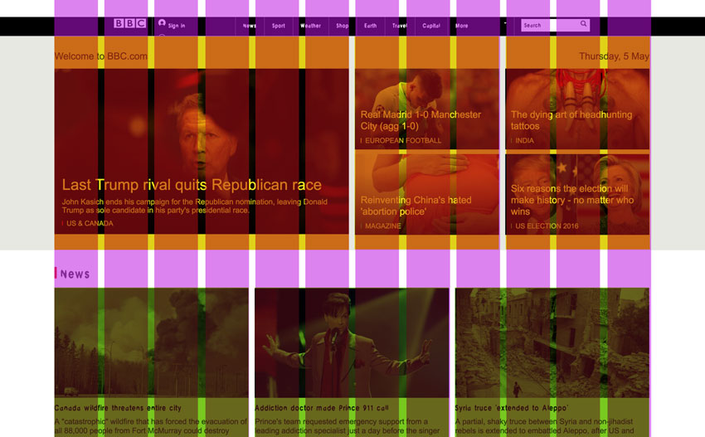
Grids
A grid can create a basic structure, a skeleton for your design. They consist of “invisible” lines upon which your design elements can be placed.
Notes:
https://webdesign.tutsplus.com/articles/a-comprehensive-introduction-to-grids-in-web-design--cms-26521

Slide 4
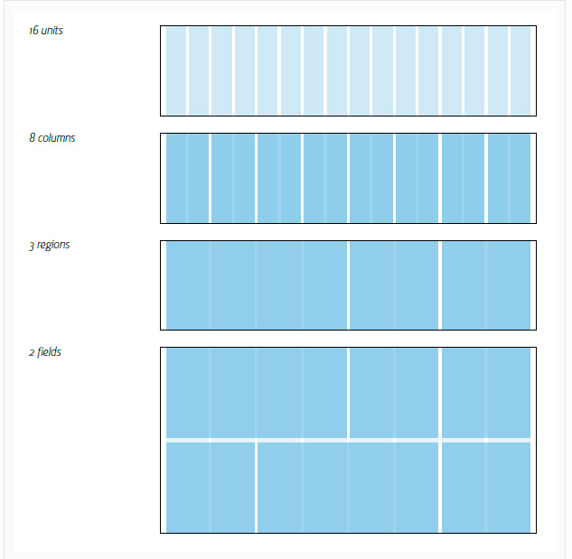
https://webdesign.tutsplus.com/articles/ordering-disorder-grid-principles-for-web-design--webdesign-2602
Notes:
https://medium.com/gravitdesigner/grids-in-graphic-and-web-design-be20e3158efd

Slide 5
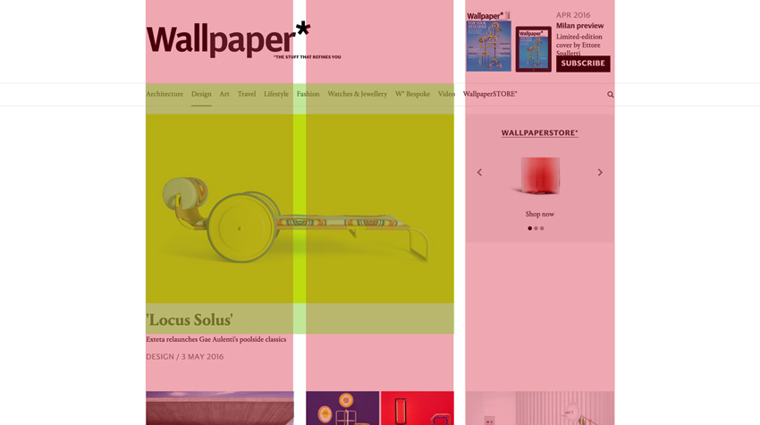
Three Column Grid

Slide 6
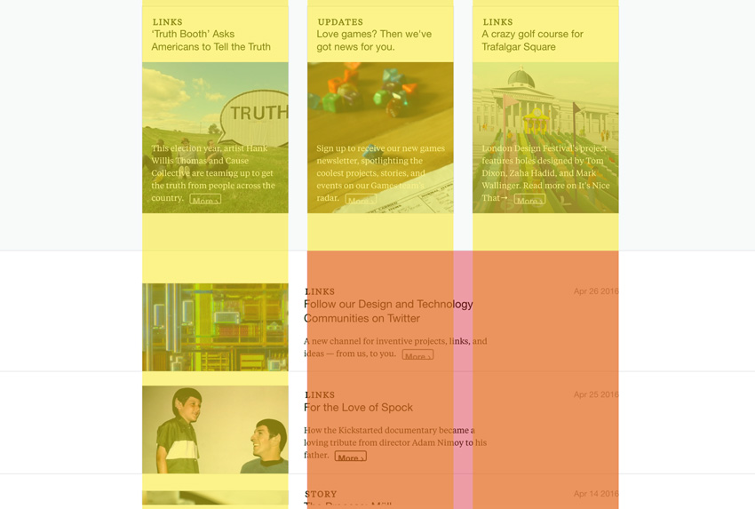

Slide 7
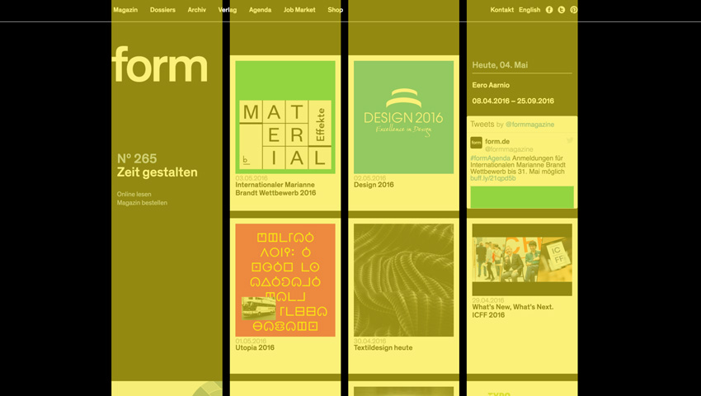
Four Column Grid

Slide 8
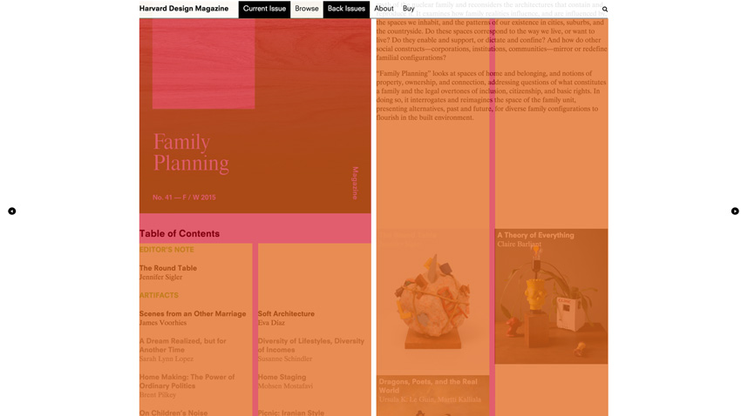

Slide 9


Slide 10
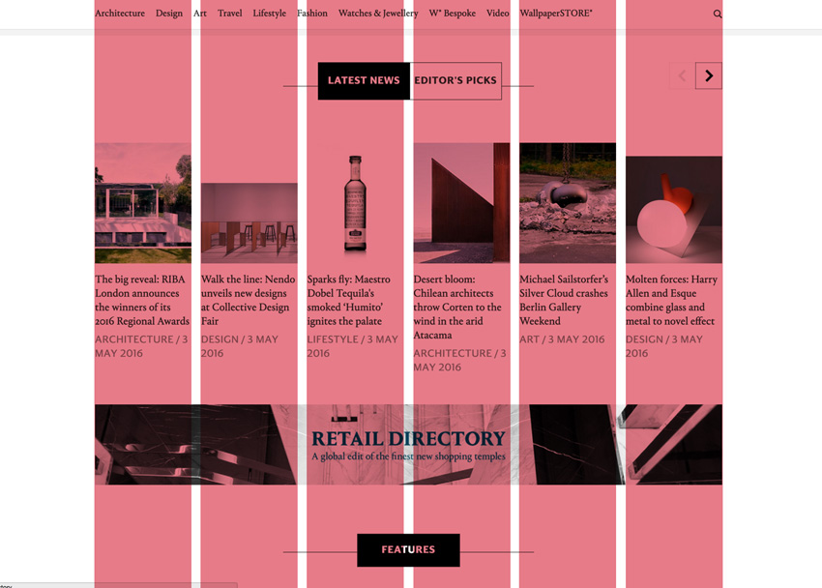
Six Column Grid

Slide 11
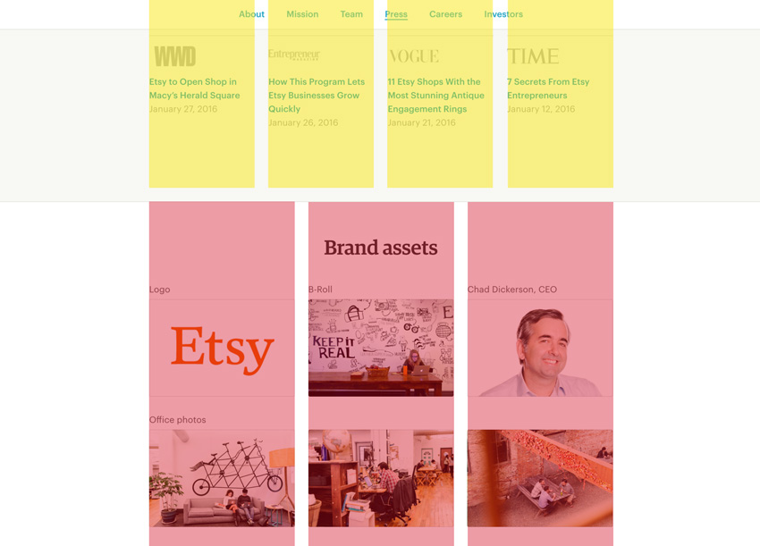
Combinations

Slide 12
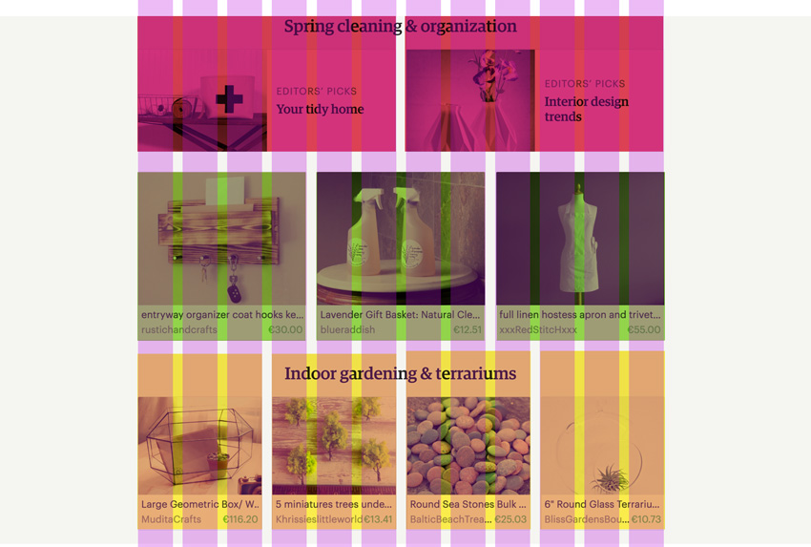
Twelve unit grid system is very handy
It easily allows you to combine blocks of three, four and six columns neatly.

Slide 13
Emphasis
Balanced and simple layouts often feel more comfortable than overly complicated ones.
The flip side is that you have to be careful not play it too safe all the time and risk looking boring.
For emphasis, you can break away from the grid or highlight certain design elements through size—by combining multiple columns, for example.

Slide 14
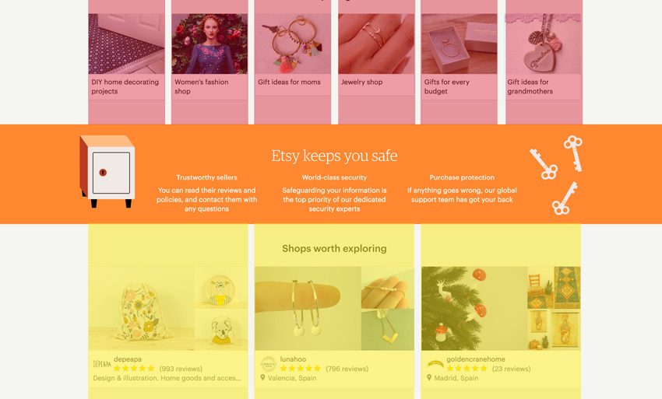

Slide 15
Rule of Thirds

Slide 16
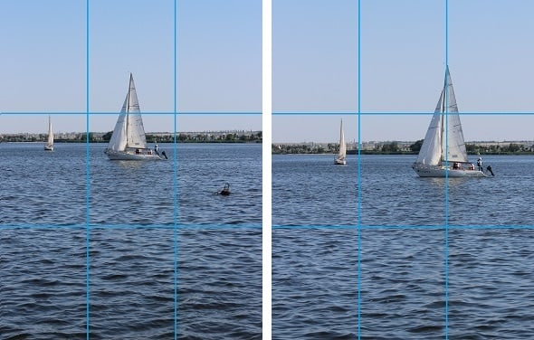
https://www.motocms.com/blog/en/rule-of-thirds-use-website-design/

Slide 17
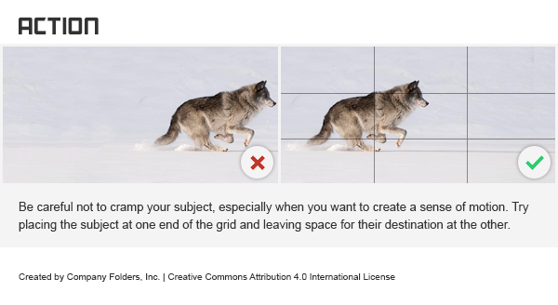
https://www.companyfolders.com/blog/rule-of-thirds-graphic-design

Slide 18

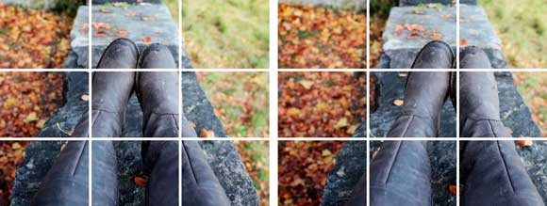
https://tympanus.net/codrops/2012/05/23/understanding-the-rule-of-thirds-in-web-design/

Slide 19

Rule of Thirds
The guideline proposes that an image should be imagined as divided into nine equal parts by two equally spaced horizontal lines and two equally spaced vertical lines
Important compositional elements should be placed along these lines or their intersections.
Notes:
https://en.wikipedia.org/wiki/Rule_of_thirds

Slide 20



Slide 21

https://www.digitaltrends.com/photography/what-is-rule-of-thirds/

Slide 22

https://www.slidegenius.com/blog/rule-of-thirds-powerpoint-design/

Slide 23
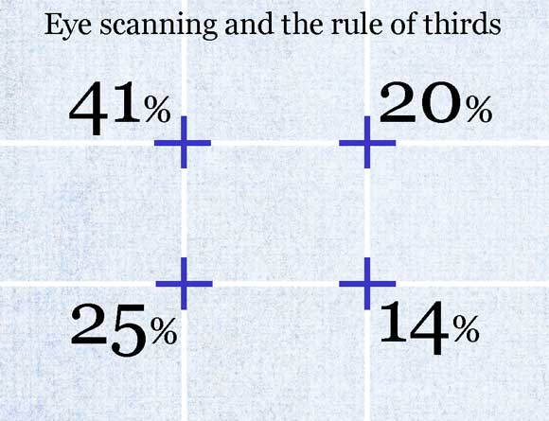
I cannot find the original resources for those numbers
https://tympanus.net/codrops/2012/05/23/understanding-the-rule-of-thirds-in-web-design/

Slide 24
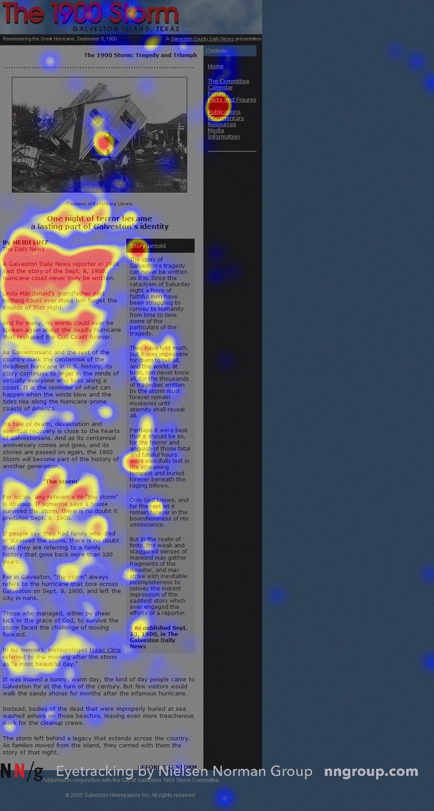
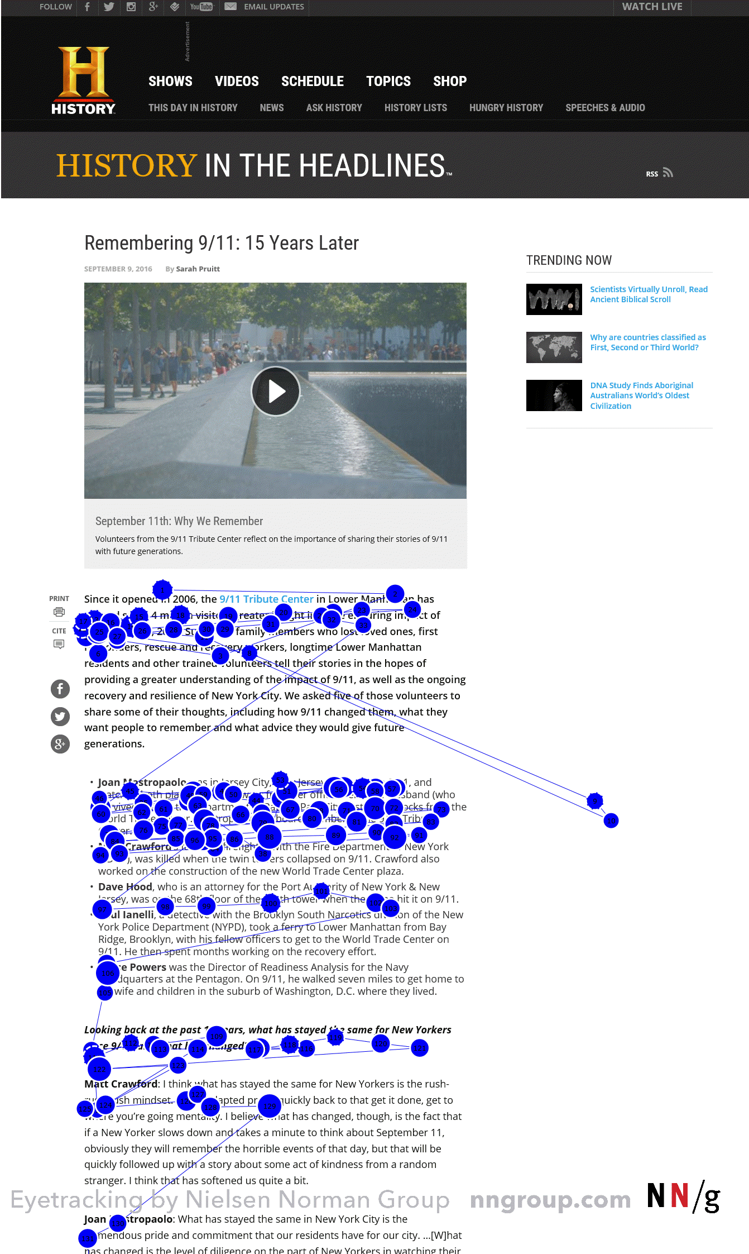
F-Shaped Pattern of Reading on the Web
https://www.nngroup.com/articles/f-shaped-pattern-reading-web-content/

Slide 25
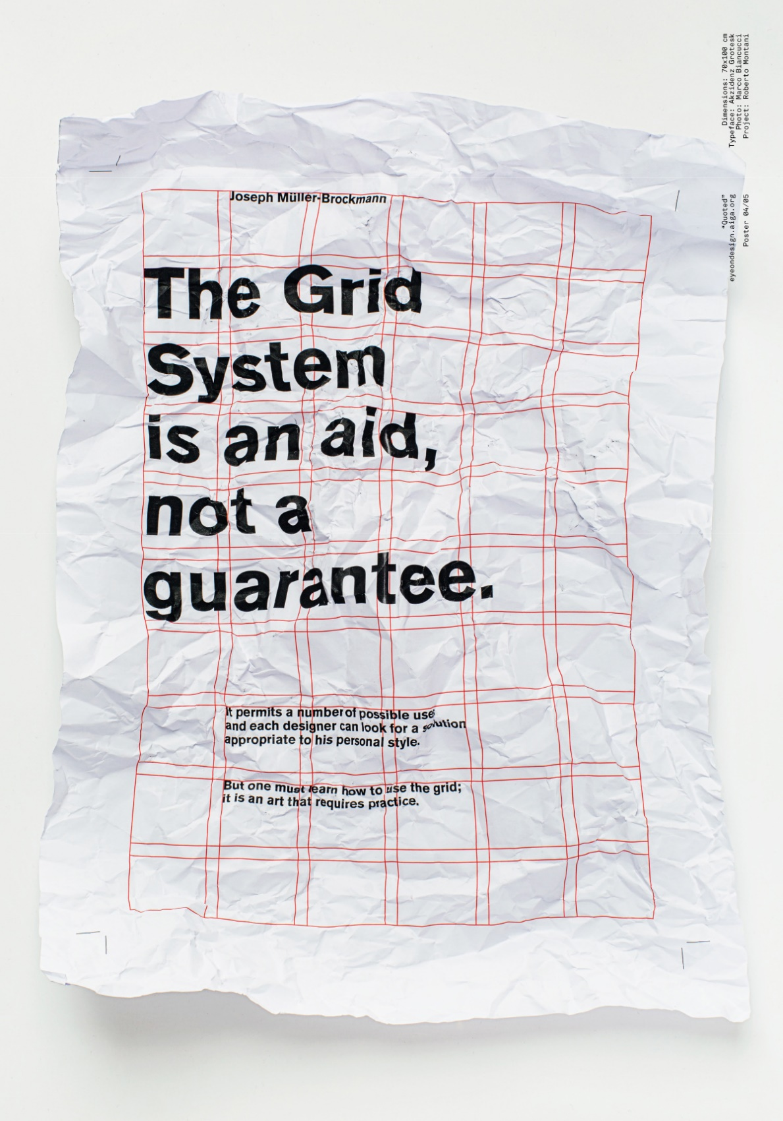
The grid system is an aid, not a guarantee.
Josef Müller-Brockmann
Notes:
https://medium.com/gravitdesigner/grids-in-graphic-and-web-design-be20e3158efd

Slide 26


Slide 27


Slide 28
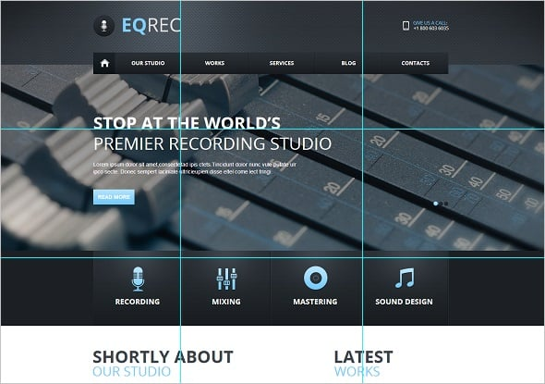

Slide 29
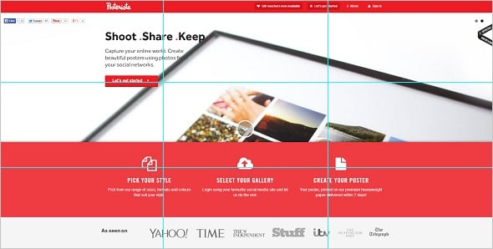

Slide 30


Slide 31

https://www.motocms.com/blog/en/rule-of-thirds-use-website-design/

Slide 32
Rule of Odds
http://compositionstudy.com/rule-of-odds/

Slide 33
Rule of Odds
The Rule of Odds states that framing your subject with 2 surrounding objects (thus creating an odd number of 3) suggests balance and harmony visually.
We tend to prefer balance and feel comfortable with these groupings of 3.
Larger numbers of objects, however can be divided visually into groupings of 3, thus bringing more cohesion to the composition.

Slide 34
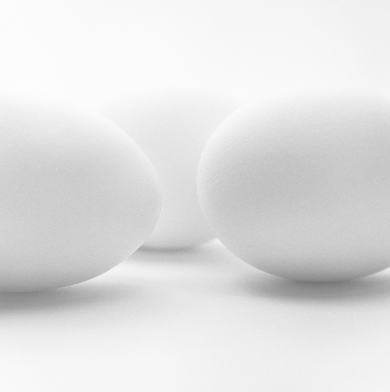
Notes:
https://www.youtube.com/watch?v=n-1tq0FEBV4

Slide 35
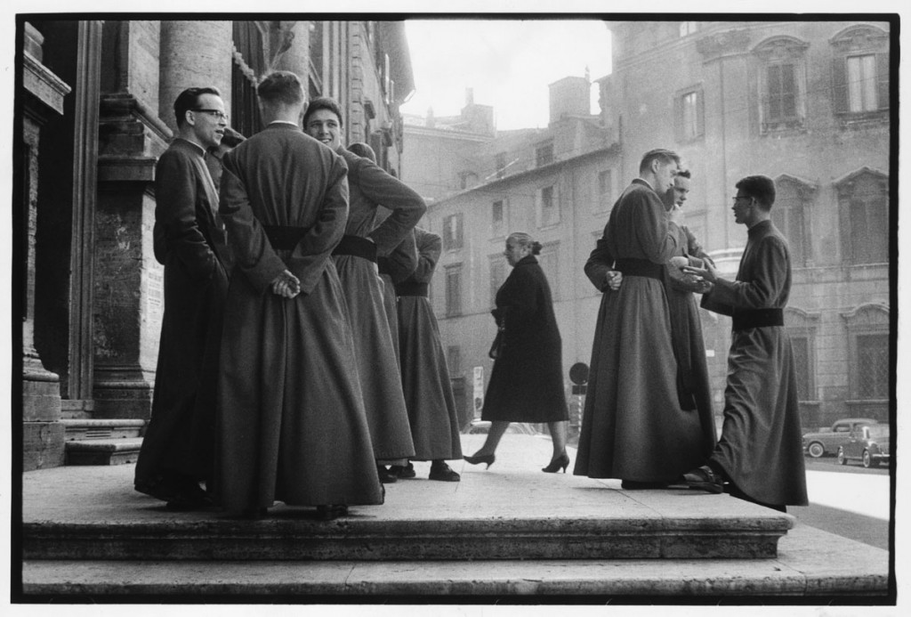

Slide 36


Slide 37


Slide 38


Slide 39
Website Layout Examples
https://theblog.adobe.com/11-website-layouts-that-made-content-shine-in-2017/

Slide 40

Single column
This layout finds application in many personal blogs based on minimalistic design principles.

Slide 41
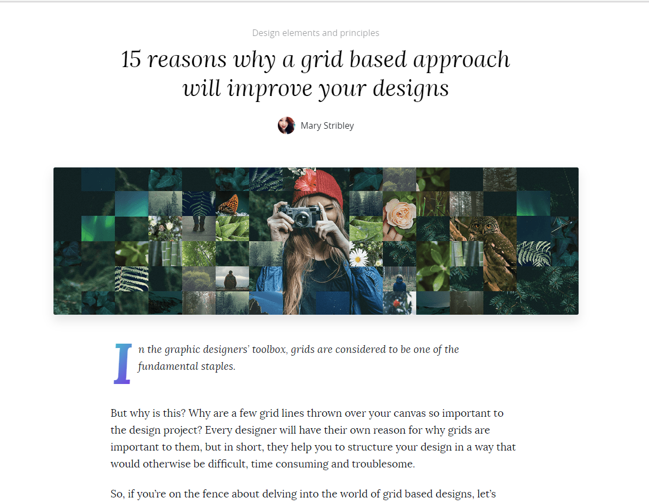
https://www.canva.com/learn/grid-design/

Slide 42
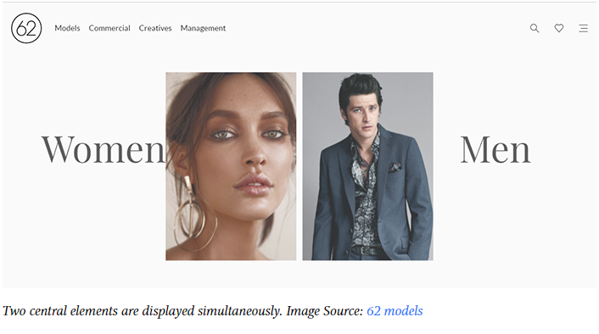
Split screen
A split screen (or one screen divided in two) layout is perfect for a page that has two main pieces of content of equal importance

Slide 43


Slide 44
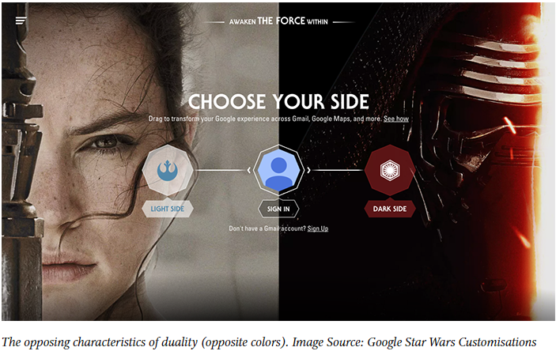

Slide 45
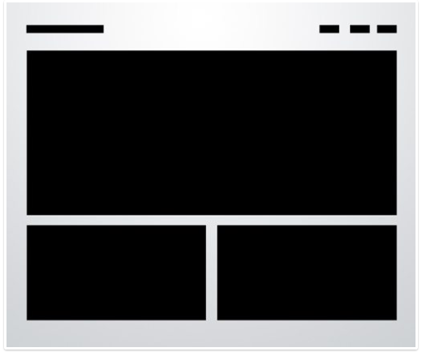
Three Boxes
https://designshack.net/articles/layouts/10-rock-solid-website-layout-examples/

Slide 46
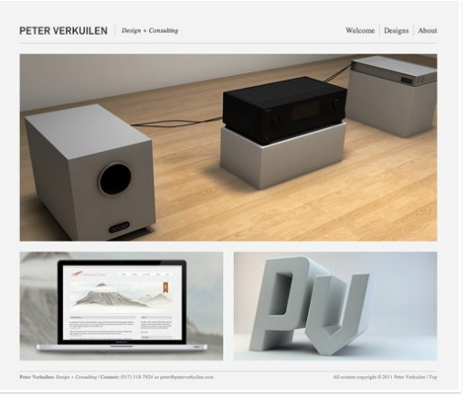

Slide 47
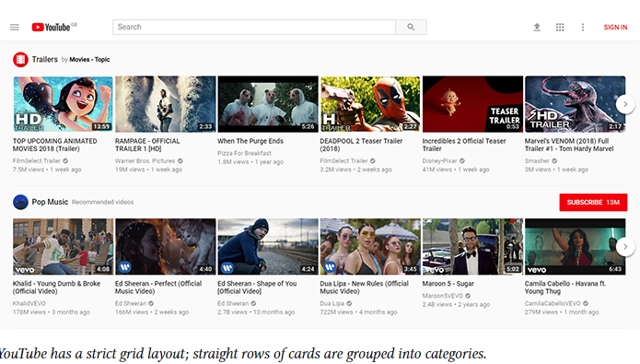
A grid of cards
Cards are great containers for clickable information

Slide 48
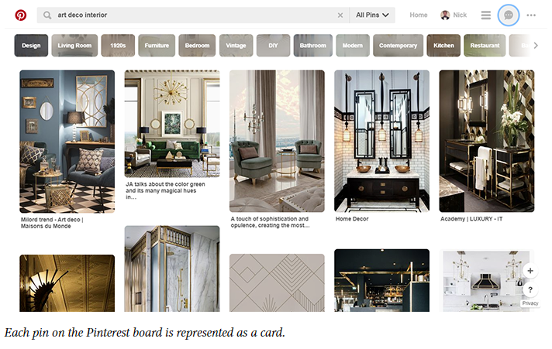

Slide 49
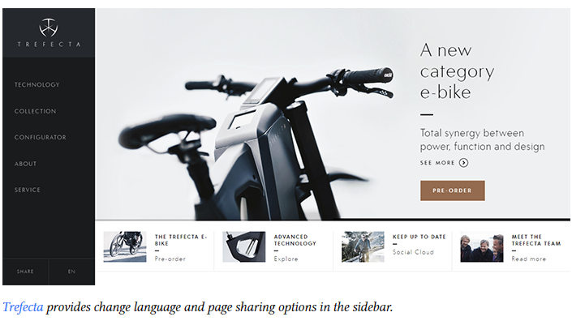
Fixed sidebar

Slide 50

https://designshack.net/articles/layouts/10-rock-solid-website-layout-examples/

Slide 51
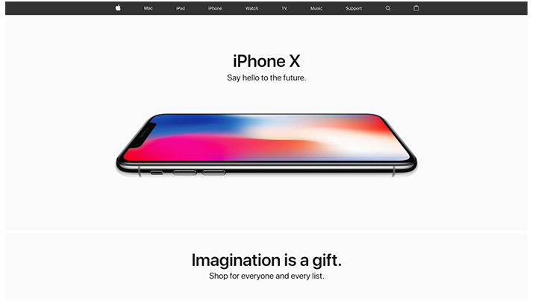
Featured image
This layout is great when you need to demonstrate only one product/service and focus a user’s entire attention on it.
Hero image

Slide 52
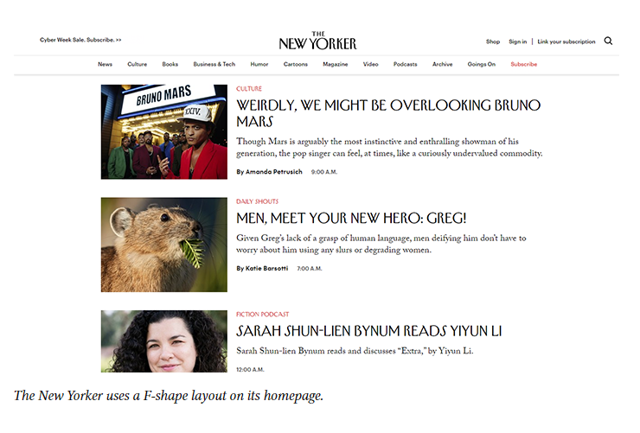
F-shape layout
This layout is good for pages that need to present a lot of different options and allow users to scan them fast.

Slide 53
More reading about Website layout
https://designshack.net/articles/layouts/10-rock-solid-website-layout-examples/
https://www.creativebloq.com/web-design/steps-perfect-website-layout-812625

Slide 54
Summary
Why does grid system usually have 12 units?
What is rule of thirds?
What is rule of odds?

